Slide 1
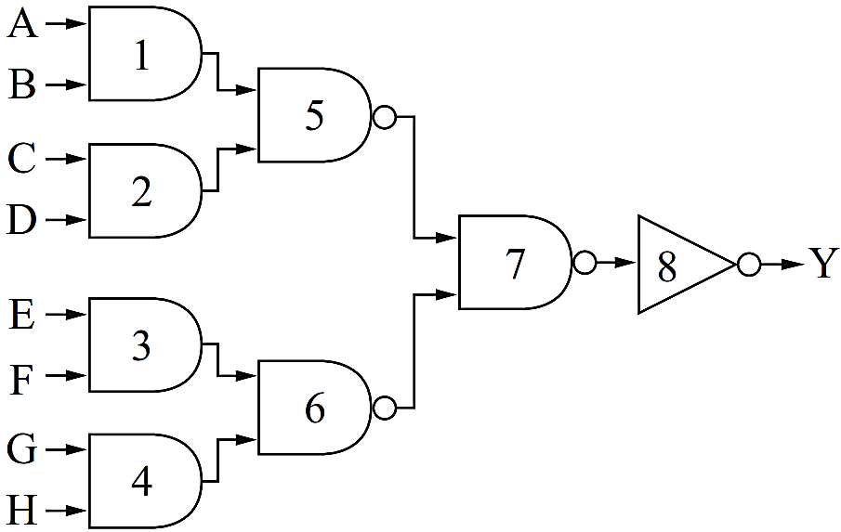
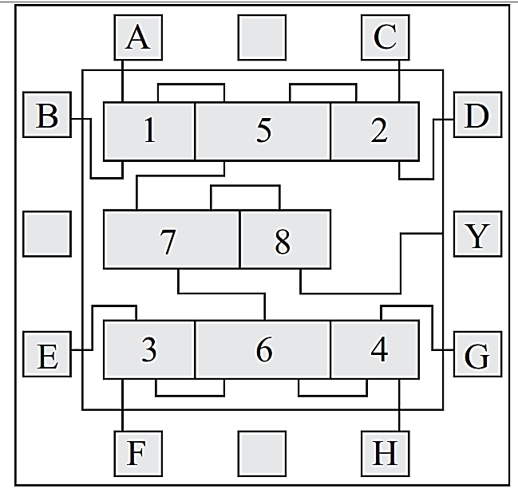
Physical design
Physical design is the process of generating the physical layout of the VLSI circuit from the schematic or gate level netlist.
Fig: A logic circuit and its corresponding layout

Slide 2
Physical design
The physical layout contains all the mask layers with their exact locations and dimensions. The physical design phase typically starts after the logic design and verification steps.
The physical design phase mainly consists of four steps
Partitioning
Floorplanning
Placement
Routing
At the end of the physical design step, the design is verified for its correctness.
Then the mask layers are generated from the layout. The mask design is sent to the foundry for integrated circuit (IC) manufacturing.

Slide 3
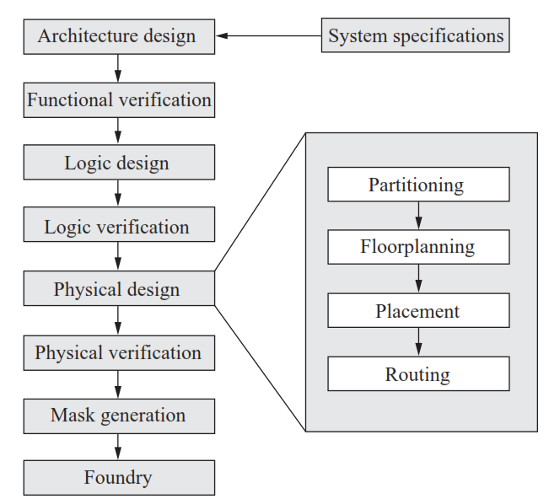
Physical design Steps
Fig: VLSI design flow with detailed physical design steps

Slide 4
Physical design Steps
Partitioning
Partitioning is a process by which the entire VLSI circuit is divided into a smaller number of sub-circuits.
The partitioning is done such that the number of interconnections between the sub-circuits are minimum.
Typically, the entire circuit is partitioned into a number of blocks based on the functionality.

Slide 5
Physical design Steps
Floorplanning
Floorplanning is the starting step of the physical design in the VLSI design flow.
In this step, it is planned to accommodate all the design components and their interconnects within a minimum area.
The components are the functional blocks such as data-path logic, control logic, memory elements, etc.
These components are of rectangular shape with different aspect ratios.

Slide 6
Physical design Steps
Floorplanning
The blocks need to be properly placed and connected within a minimum area.
Floorplanning step comes up with a two-dimensional layout with a plan of each block.
In electronic design automation (EDA), a floorplan of an IC is a schematic representation of tentative placement of its major functional blocks.

Slide 7
Floorplanning Goals
Floorplanning
The goals of floorplanning step are as follows:
To arrange the blocks on the chip
To decide the I/O pad locations
To decide the number of power pads and their locations
To decide the power distribution style
To decide the clock distribution and their locations

Slide 8
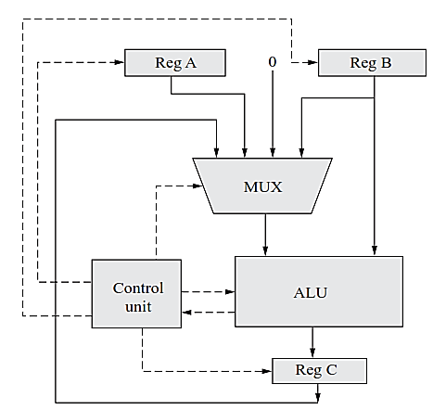
Partitioning
The whole circuit is partitioned into six major blocks. Each block is represented by a rectangle which has a fixed amount of area requirement.

Slide 9
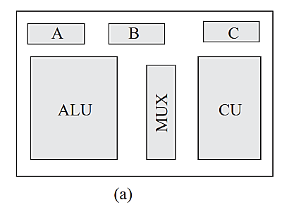
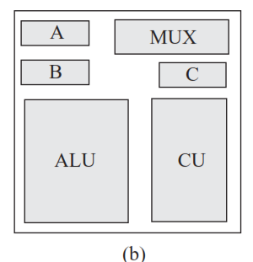
Floorplanning
The blocks are then planned in an estimated area by an initial floorplan.

Slide 10
Physical design
Netlist
A netlist is a representation of the actual design in any formal hardware description language (VHDL or Verilog).
It contains all the functional and control logic cells and blocks, soft and hard macros, memory blocks, registers, etc.
It also describes the input and output ports of each block and the connectivity between the blocks.

Slide 11
Floorplanning: flexible or fixed block
During the floorplanning, it is also required to know if any block is flexible or fixed.
A flexible block is normally made of standard cells; hence, standard cells size is fixed, but they can be rearranged so that the block shape is flexible.
Whereas fixed blocks are not alterable.
So, after placing the fixed blocks, the flexible blocks can be placed at the vacant areas.
Although the blocks are planned, it is very important to allocate space for inter connects between the blocks. The process of space allocation for interconnects is known as Channel definition.

Slide 12
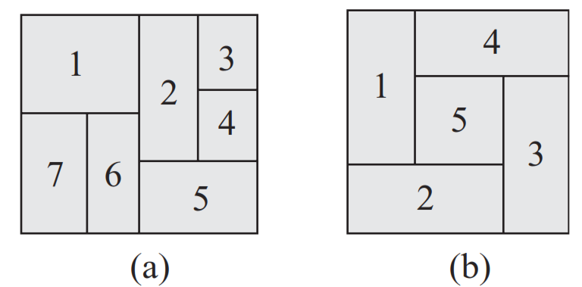
Floorplanning classes
Two types of floorplanning classes are normally used:
Slicing floorplan
Non-slicing floorplan
Fig: Floorplan: (a) slicing; (b) non-slicing
In slicing floorplan, the whole die area is first partitioned into two slices of equal or unequal sizes using either a horizontal or vertical line. Individual blocks are again partitioned into two by using either horizontal or vertical lines. This process continues until all the blocks are separated. This process of partitioning a die area is called slicing floorplan.

Slide 13
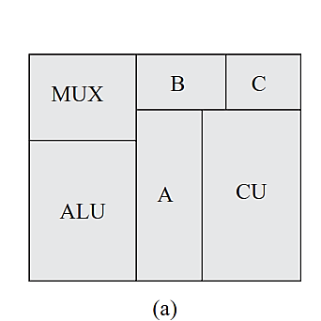
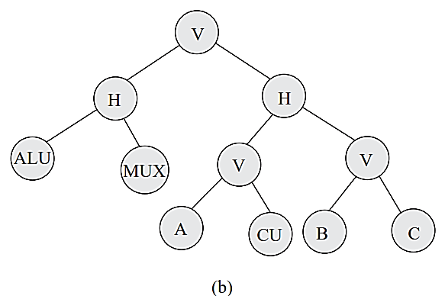
Floorplanning classes
The slicing floorplan is represented by a binary tree structure known as slicing tree. The leaf nodes of the slicing tree are the blocks of the design. The other nodes are either represented by V or H. H signifies a horizontal partition, whereas V signifies a vertical partition.
Fig: (a) Slicing floorplan; (b) slicing tree

Slide 14
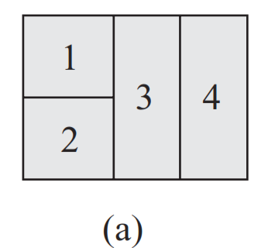
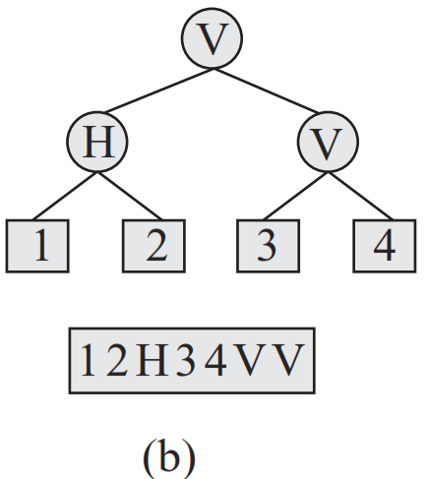
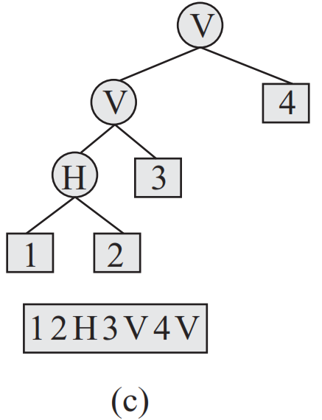
Sizing Algorithm for Slicing Floorplans
Fig: (a) Slicing floorplan; (b) slicing tree; (c) Alternative slicing tree

Slide 15
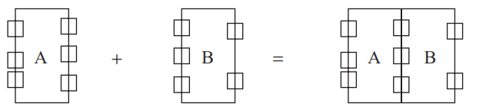
Floorplanning classes
Non-slicing Floorplan
If a floorplan is obtained with no recursive through cuts, it is called non-slicing floorplan.
It is also known as wheel or spiral floorplan. In this floorplan, the blocks are not obtained by bisections.
But it must have at least five blocks.
Abutment
It is a process of placing two blocks adjacent to each other without leaving any space between them for interconnections
Fig: Two blocks are joined by abutment

Slide 16
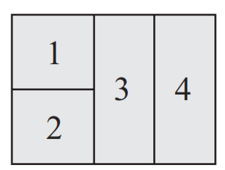
Floorplanning Algorithms
There are several floorplanning algorithms.
Sizing Algorithm for Slicing Floorplans (using Polish Expression )
Wong–Liu Algorithm
Fig: Sample Slicing Floorplans

Slide 17
Sizing Algorithm for Slicing Floorplans
Sizing algorithm for slicing floorplans are as follows:
The shape functions of all leaf cells are given as piecewise linear functions*.
2. Traverse the slicing tree in order to compute the shape functions of all composite cells (bottom–up composition).
3. Choose the desired shape of the top-level cell; as the shape function is piece-wise linear, only the break points of the function need to be evaluated, when looking for the minimal area.
4. Propagate the consequences of the choice down to the leaf cells (top–down propagation).
*A piecewise linear function is a function defined on the a (possibly unbounded) interval of real numbers, such that there is a collection of intervals on each of which the function is an affine function. If the domain of the function is compact, there needs to be a finite collection of such intervals; if the domain is not compact, it may either be required to be finite or to be locally finite in the reals.

Slide 18

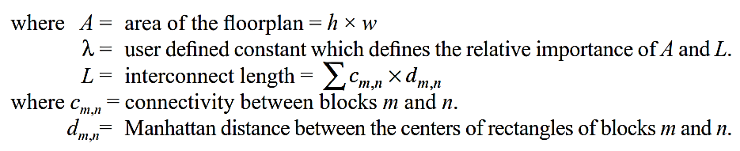
Wong–Liu Algorithm
If a slicing floorplan is represented by a slicing tree and each internal node of the slicing tree is labelled by V or H,
A polish expression will be obtained if the slicing tree is traversed in post-order.
The polish expression is called normalized if there is no consecutive V’s or consecutive H’s in the sequence.
There is a one-to-one mapping between the set of normalized polish expressions of length (2N − 1) and the set of slicing floorplans with N modules.
The floor-planning cost is defined by the following expression:

Slide 19
Physical design Steps
Placement
Floorplanning step generates an initial layout of a design with the location of the fixed block, and location and shape of the flexible blocks.
In the placement step, the logic cells are placed within the flexible blocks. It determines the physical layout of a chip.
The routability of the layout is mainly determined by the placement.
The objectives of the placement step are as follows:
1. Minimize the chip area.
2. Minimize the delay on critical paths.
3. Ensure that layout is routable.
4. Minimize power dissipation of the design.
5. Minimize the crosstalk between the signals.

Slide 20
Physical design Steps
Routing
Routing simply means drawing paths from the source to the destination in a layout.
In this step, the interconnection lines are drawn for the signal, power, ground, and clock nets.
Although it seems a pretty simple process, it is a very hard problem to solve when the number of connections is very large.
The objectives of routing are to
Minimize area of the chip
Minimize total wire length in the chip
Minimize layer changes for interconnection
Minimize net delay on critical paths

Slide 21
Placement Algorithms
There are mainly two categories of placement algorithms
Constructive placement
Min-cut algorithm
Clustering method
Iterative placement
Kernighan–Lin Algorithm

Slide 22
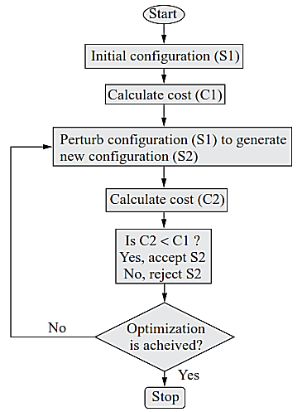
Placement Algorithms : Iterative Placement
In the iterative placement, an already placed layout is taken, and the placed cells are perturbed or moved around to generate a new placement. If the new placement is better than the old one, the old one is replaced by the new one. This way the placement can be improved; hence, the method is also called iterative placement improvement.
The algorithm consists of the following basic steps:
Initial configuration
Cost computation
Perturb to generate new placement
Checking the acceptance criteria
Stop if the number of iterations reach the limit
Fig: Flowchart for the iterative placement

Slide 23
Routing
Routing simply means drawing paths from the source to the destination in a layout.
Following points are to be considered while routing:
Presence of obstacles
Wire orientation in a layer (H, V)
Design rules on wire width and separation
Number of terminals (usually two, but can be many for power and clock nets)
Terminal positions (channel, switch box), Fixed vs floating terminals
Net width (signal nets have less width but power/ground nets have greater width)
Number of layers (number of metal layers)
Net types (power, ground, clock, or signal net)
Yield
Heat and power dissipation
Signal integrity (noise, crosstalk, power bounce)

Slide 24
Types of Routing
Routing can be classified into two main categories:
Global routing : the routing is planned
Sequential approach
Concurrent approach
Detailed or local routing : the actual routing is done
Area routing
Channel routing
In area routing, the routing is carried out with obstacles.
It is also called maze routing.
This routing problem is to find the shortest path between two terminals on a grid with obstacles.
In channel routing, dedicated space called routing channels are provided for routing. Channel routing is very much suitable for standard cell-based design.

Slide 25
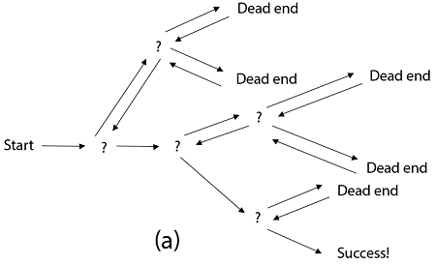
Backtracking

Slide 26
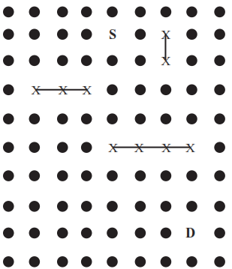
Area Routing by Lee’s Algorithm
Problem:
This algorithm is used where the positions of the source and destination are throughout the entire area of the chip.
This type of routing problem is known as the area routing problem.
The aim of this algorithm is to draw a path from a source to a destination, avoiding any obstacles.

Slide 27
Area Routing by Lee’s Algorithm
Solution:
The whole area is divided into a grid structure, where the separation between the grid points indicates the minimum wire width and their spacing.
The routing blockage is modelled as obstacles and are marked as ‘X’ as shown in Fig.
The grid points are shown by dots, and the source and destination are represented by ‘S’ and ‘D’.
Step- Wave Propagation
A path between two points is realized by propagating a wavefront from the source node outwards until the destination node is reached. This methodology is termed as wave propagation.

Slide 28
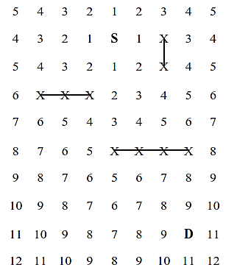
Area Routing by Lee’s Algorithm
Step- Wave Propagation (Cont.)
Starting from the node ‘S’, the grid points are labelled.
The labelling is done by putting integer ‘1’ to the grid points belonging to firstwave front.
The grids belonging to second wavefront are labelled by integer ‘2’.
This process continues until the destination node ‘D’ is reached.
Fig: wave propagation from S to D

Slide 29
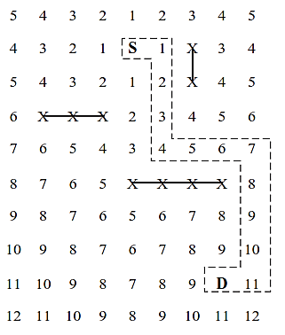
Area Routing by Lee’s Algorithm
Step- Backtracing
In the second step, starting from the destination node ‘D’, the shortest path is
identified by backtracing the grid points with decreasing labels.
Fig: connected path from S to D

Slide 30
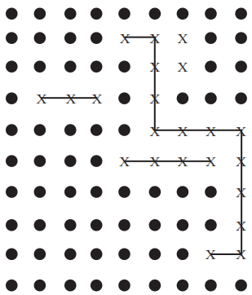
Area Routing by Lee’s Algorithm
Step- Clean-up
The path found using the wave propagation and backtracing methods become obstacles for the next routing problem. So the labels of all the grid points are removed so that next routing task can be taken up. This step is known as clean-up.
Fig: found path becomes obstacle for next problem

Slide 31
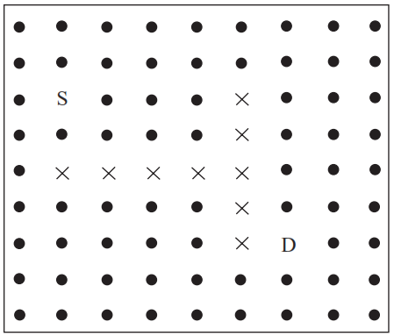
Assignment
Find out the shortest path between the source (S) and the destination (D) as
Shown in the following figure using Lee's routing algorithm. The symbol indicates obstacles.

